Slide 1
Why Does China End the One-Child Policy?
Sara Lam
December 2015

Slide 2
Define the problem and software
China announced on October 29, 2015 that it is ending the one-child policy as graying population poses risks to the economic growth. All Chinese couples will be allowed to have two children.
This 35-year-old policy went through different stages in curbing or relaxing the control on population.
This project will explore details on economic and social issues as a result of the one-child policy, as well as explore the impact of changing to two-child policy.
Python is used for data analysis and creating graphs. Data is collected from various websites. Enthought Canopy is used to run Python codes.

Slide 3
Define goals and objectives
The goals of the project are to explore the following questions in order to understand the impact of the one-child policy, and estimate the impact of the change in policy -
What are the major milestones of government interventions?
As a result, what is the trend of population growth in the past few decades?
What is the age composition, and the dependency ratio?
What is the projected trend for the working age group?
What other social issues are created by the one-child policy?
What is the projected population trend, and will the end of one-child policy reverse the trend?

Slide 4
What are the major milestones of government interventions?
1970: China’s population exceeds 800 million. With the fertility rate at 5.5, the country implements policy to encourage people to marry later and wait longer between children.
1980: China implements one-child policy - China’s fertility rate dropped to 2.7 in 1979, from 5.5 in 1970 due to a policy encouraging people to marry later, wait longer between children, and have fewer babies. Still, lingering overpopulation fears led the leadership to enact the one-child policy.
2000: Demographers began to present a united front, arguing that China was dangerously close to falling below a replacement rate of 2.1 children for every woman.
2013: An exemption allows two children if one parent came from a household without other siblings.
2015: The Chinese government ends the one-child policy, allowing all couples to have two children.

Slide 5
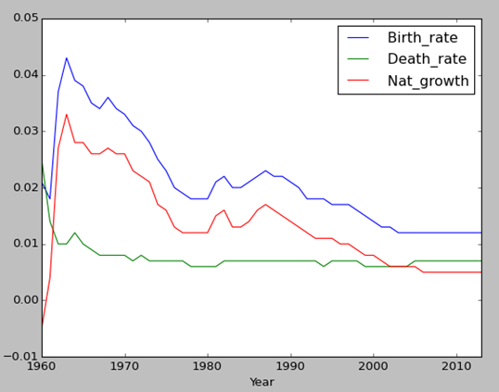
As a result, what is the trend of population growth in the past few decades?
China’s birth rate has dropped significantly from more than 4% in the early 1960’s to about 1.2% in 2003, and plateauing at 1.2% since then, while the death rate stays steadily at around 0.6% to 0.7%.
This means the natural growth rate has dropped from 2% to 0.5% in the past few decades.
Figure 1

Slide 6
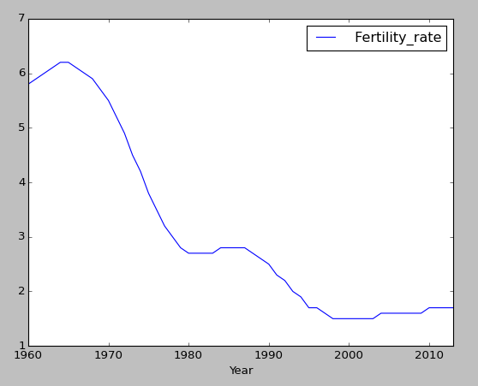
As a result, what is the trend of population growth in the past few decades?
China’s fertility rate has dropped from 5.8 in 1960 to 1.7 in 2014, below the replacement rate of 2.1.
Figure 2

Slide 7
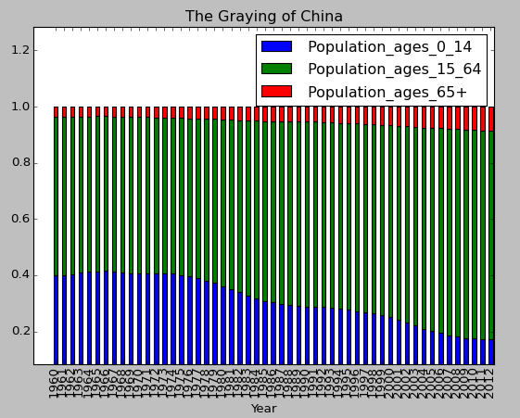
What is the age composition, and the dependency ratio?
Since 1970, the percentage of young people ages 0 to 14 has steadily dropped from about 40% to 17% in 2014.
On the other hand, percentage of elderly people ages 65 and above has increased from 4% to 9% from 1970 to 2014.
Figure 3

Slide 8
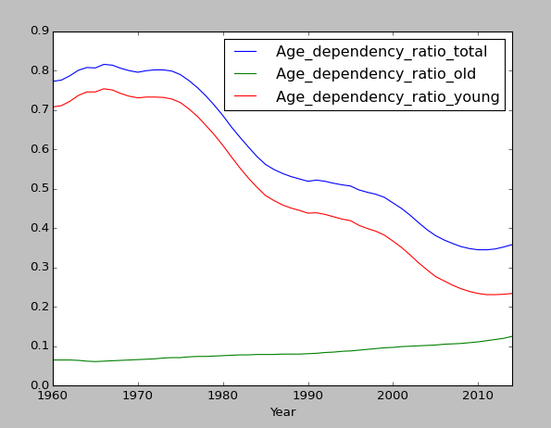
What is the age composition, and the dependency ratio?
As birth rates dropped and people live longer due to better healthcare and economic conditions, the ratio of elderly people to working age group is increasing.
Figure 4

Slide 9
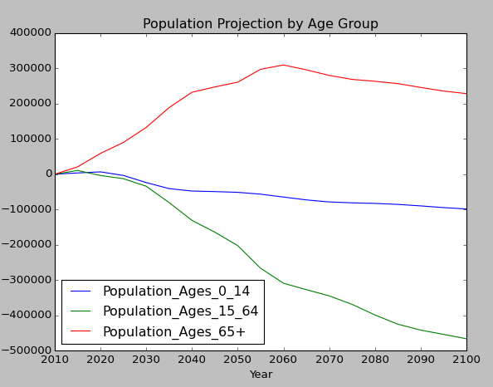
What is the projected trend for the working age group?
Using 2010 as the base year, population of ages 65 and above will increase, while population of ages 0 to 14 as well as 15 to 64 will decrease, creating a shortage of workers and higher dependency ratio in the coming decades.
Figure 5

Slide 10
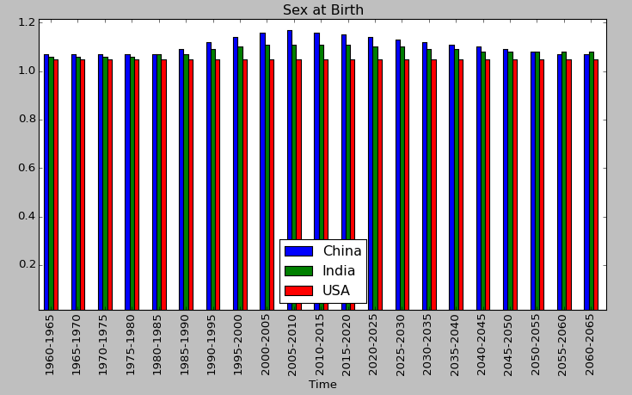
What other social issues are created by the one-child policy?
With cultural pressures to have boys to carry the family name and take care of older parents, about 116 boys were born for every 100 girls in China, compared with the World Health Organization’s natural rate of around 105 to 100.
Comparing sex at birth ratios of China, India and the United State - the ratios for the US are close to natural rate. India has similar cultural pressures to have boys; however, without the one-child policy, India’s ratios are less severe than those of China.
Figure 6

Slide 11
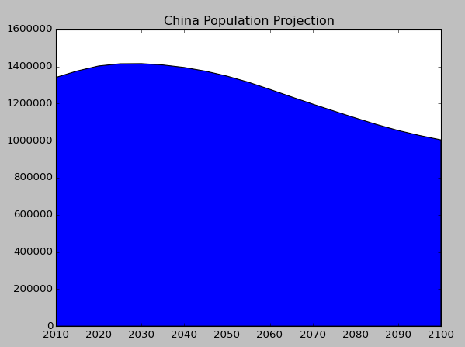
What is the projected population trend, and will the end of one-child policy reverse the trend?
Without changes to the one-child policy, China’s population is projected to decline.
Figure 7

Slide 12
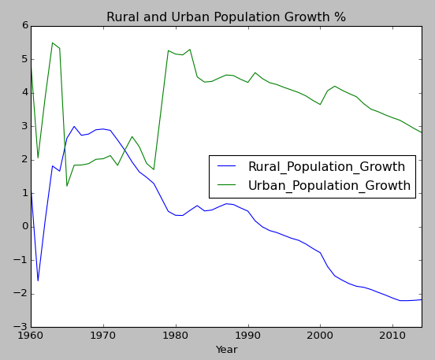
What is the projected population trend, and will the end of one-child policy reverse the trend?
Even without the one-child policy, many Chinese worry about the expense of a second child in a country where education and products for children can be costly.
The last easing in 2013 resulted in 1.45 million new birth applications, according to China’s National Health and Family Planning Commission. The number was far lower than experts expected.
Even rural residents, many of which have been exempt of the one-child policy, are reluctant to have bigger families, largely because of the costs associated with having more than one child.
Figure 8

Slide 13
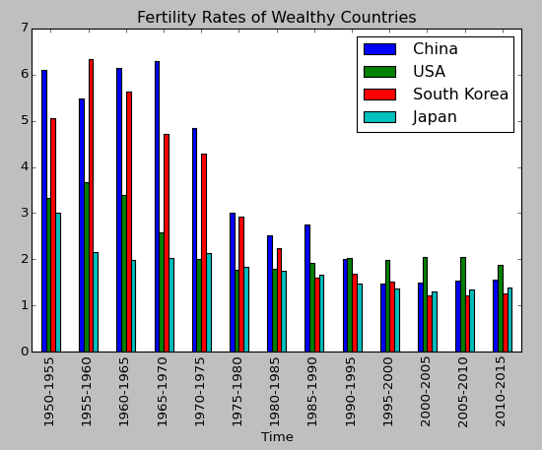
What is the projected population trend, and will the end of one-child policy reverse the trend?
Demographers argue that China’s population trends will follow countries like the U.S., South Korea and Japan in falling birthrates as the population becomes more affluent and educated.
This means China’s fertility rate is expected to stay below the 2.1 replacement rate in the future.
Figure 9

Slide 14
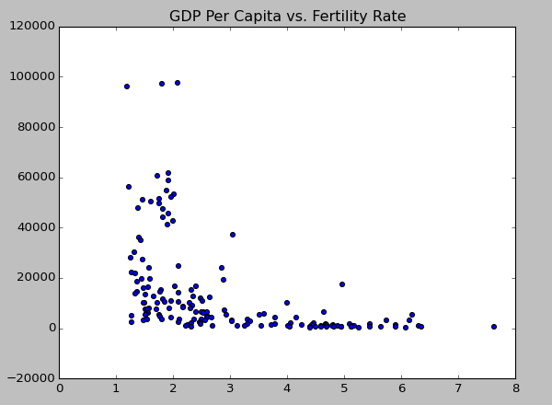
What is the projected population trend, and will the end of one-child policy reverse the trend?
Research shows an inverse correlation between wealth and fertility among nations. The higher the degree of GDP per capita, the fewer children are born in a country.
As China becomes more affluent, the fertility rate is expected to stay low.
Figure 10

Slide 15
Conclusion
The new two-child policy will likely do too little to change China’s economic course and comes too late to solve a looming labor crisis.
The dilemma is that overpopulation in China will still exist in the long term; however, the percentage of the elderly will increase, while the workforce will shrink.
However, China will likely have a large population of robots to automate jobs previously handled by human beings. This can help mitigate the risks from workforce shortage.
Even if the two-child policy is unable to contribute significantly to economic growth, it will likely decrease the gender preference. Studies show when families were allowed to have multiple children, the sex ratio was far more balanced. Also because China is aging, it may move toward a preference for women, because women are typically thought of as better caretakers.

Slide 16
Recommendations for future improvements
Over the next few years after the end of one-child policy, conduct analysis on population data and create different scenarios for future projections.
Use various forecasting techniques to estimate population trends by changing assumptions. E.g. what if with government incentives, 20% of Chinese couples will have 2 or more children; what if 50% of the couples will have 2 or more children?
Run regression analysis to identify relationships between population growth and other factors, e.g. GDP, consumer spending, education, etc.
Explore how automation will change the competitive landscape in the global economy. Will companies still move to high workforce areas with low wages, or will they increase automation?
Explore how other factors, combined with population growth, affect the economy, e.g. globalization, demographic changes, inflation, fiscal policy, etc.

Slide 17
Data sources and reference
United Nation Population Division - http://esa.un.org/unpd/wpp/Download/Standard/Population/
China Statistical Yearbook - http://www.stats.gov.cn/tjsj/ndsj/2014/indexee.htm
https://en.wikipedia.org/wiki/Demographics_of_China
http://www.wsj.com/articles/china-abandons-one-child-policy-1446116462
http://www.wsj.com/articles/how-demographics-rule-the-global-economy-1448203724
http://www.cnn.com/2015/10/29/china/china-one-child-policy-ends-mckenzie/index.html?eref=rss_world
http://data.worldbank.org/indicator/NY.GDP.PCAP.CD

Slide 18
Python codes – Figure 1 – Natural Growth Rate
import pandas as pd
import numpy as np
import matplotlib.pyplot as plt
data1 = pd.read_csv('C:\IU\Fall 2015\Final Project\China Population\Natural Growth.csv') data1=data1.set_index('Year')
data1.plot()

Slide 19
Python codes – Figure 2 – Fertility Rate
data7 = pd.read_csv('C:\IU\Fall 2015\Final Project\China Population\Fertility Rate.csv')
data7 = data7.set_index('Year')
data7.plot()

Slide 20
Python codes – Figure 3 – Age Composition
data2 = pd.read_csv('C:\IU\Fall 2015\Final Project\China Population\Ages.csv')
data2 = data2.set_index('Year')
data2.plot(kind='bar', stacked=True)

Slide 21
Python codes – Figure 4 - Dependency
data3 = pd.read_csv('C:\IU\Fall 2015\Final Project\China Population\Dependency.csv')
data3 = data3.set_index('Year')
data3.plot()

Slide 22
Python codes – Figure 5 – Age Group Projection
data5 = pd.read_csv('C:\IU\Fall 2015\Final Project\China Population\Population Projection.csv')
data5=data5.set_index('Year')
data5.plot(title='Population Projection by Age Group')

Slide 23
Python codes – Figure 6 – Sex at Birth
data4 = pd.read_csv('C:\IU\Fall 2015\Final Project\China Population\Sex at Birth.csv')
data4=data4.set_index('Time')
plt.title("Sex at Birth")
data4.plot(kind='bar')

Slide 24
Python codes – Figure 7 – Population Projection
data6 = pd.read_csv('C:\IU\Fall 2015\Final Project\China Population\Total Population Projection.csv')
x=data6['Year']
y=data6['Total_Population']
plt.fill_between(x,0,y,facecolor='blue')
plt.title("China Population Projection")

Slide 25
Python codes – Figure 8 – Rural & Urban Growth
data8 = pd.read_csv('C:\IU\Fall 2015\Final Project\China Population\Rural and Urban.csv')
data8=data8.set_index('Year')
data8.plot(title = "Rural and Urban Population Growth %")

Slide 26
Python codes – Figure 9 – Fertility Rates of Wealthy Countries
data9 = pd.read_csv('C:\IU\Fall 2015\Final Project\China Population\Fertility of Wealthy Countries.csv')
data9=data9.set_index('Time')
data9.plot(title = "Fertility Rates of Wealthy Countries", kind='bar')

Slide 27
Python codes – Figure 10 – GDP per Capital vs. Fertility Rate
data10 = pd.read_csv('C:\IU\Fall 2015\Final Project\China Population\GDP and Fertility.csv')
x=data10['Fertility_Rate']
y=data10['GDP_Per_Capita']
plt.scatter(x,y)
plt.title('GDP Per Capita vs. Fertility Rate')

